Slide 1















Project MetaTiger
Application For Metadatas Salesforce
Bruno Ribeiro, Salesforce Application Architect at Ipiranga, BR

Slide 2

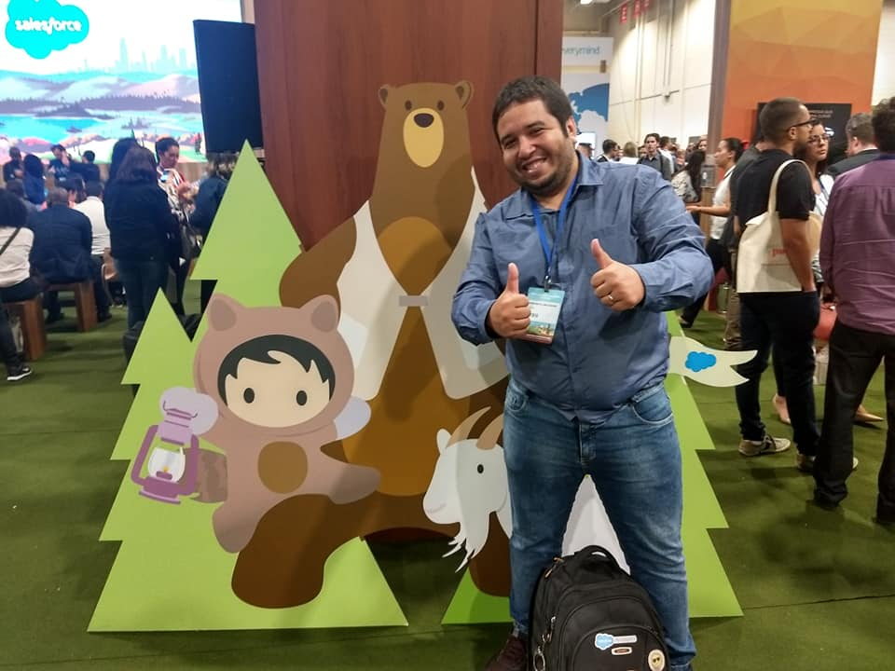








Presentation
Who is Bruno Ribeiro?
I'm a trailblazer.
From four to five years working with Salesforce platform.
.Net Platform Developer.
Salesforce Application Architect
at Ipiranga Produtos de Petróleo S.A.
Single view of the Customer
I'm married.
Father of five dogs and two cats.
I'm a nerd.
Resident of Campo Grande RJ, Brazil.

Slide 3








Acknowledgement
Thanks to the people who helped me at this stage.
Initially, I thank my parents, my wife very much for helping me along this journey, below are the people who gave feedback and contributed knowledge about MetaTiger
Daniel Corrêa
Salesforce Architect at Globosat
Rafael Santos - Solution Architect
at Salesforce
Iuri Soares - Salesforce
Solutions Architect at Ipiranga
Gabriel Rodrigues - Salesforce Developer at Grupo GFT
Single view of the Customer
Jorge Mimica
Developer Salesforce at Bullhorn
Leonardo Carvalho
Developer Salesforce at SulAmerica
Tiago Nascimento-
Certified Salesforce Application & System Architect at Salesforce

Slide 4


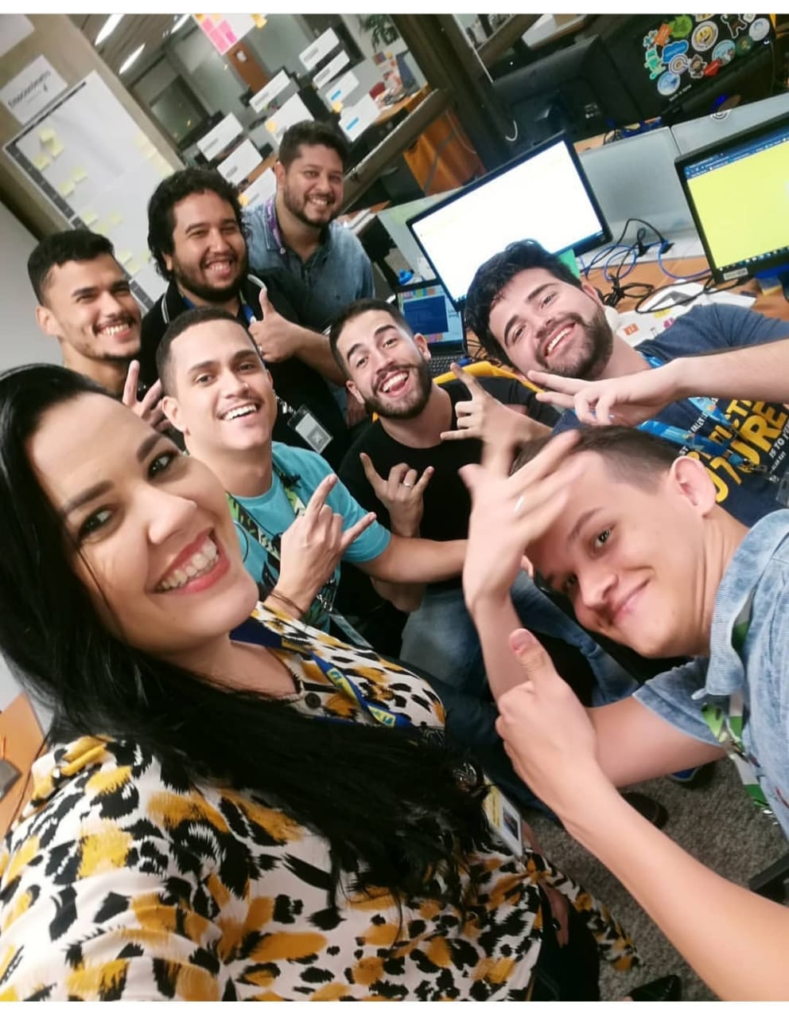

Acknowledgement Ipiranga
Thanking Team Ipiranga.
Betsy Rabello Ferreira
CIO | Ipiranga Produtos de Petróleo
Bernardo Pinto
Gerente de Sistemas | Ipiranga Produtos de Petróleo
Single view of the Customer
Squad Salesforce - Ipiranga Produtos de Petróleo

Slide 5
One solution to every problem.

Slide 6


One solution to every problem.
Let's talk about issues with Salesforce customers!
What already has all customizations in the organization?
What can I do not to use the Salesforce change set? I need use an repository for metadatas.
What did I change this week, what did I team change? I need to deploy these changes.
I have to choose 50 classes, 5 objects, 3 profiles, from my repository to create a package.
I need to make a selection of custom fields, layouts, and record types to add just that to an existing object in the repository.

Slide 7




What can I do to improve this ?
What to do for so many problems a day?

Slide 8
And the solution thought was?

Slide 9



The metadata tiger was the solution. It was the beginning of the development of MetaTiger.
I had thought the robot should be fast, practical, and robust, and I used the .NET experience to my advantage. And it helps in the role of release manager

Slide 10


How to install MetaTiger
Install Visual Studio Code. (Optional)
Install Git
Install SDK do .NET Core 2.2 Download
Git Terminal:
URL: git clone https://github.com/brunoslribeiro/sfdc-meta-tiger
In VisualCode or Prompt Command/Terminal
Execute command --> dotNet run
Just select the options below and use the tool normally it will prompt you for the required information.

Slide 11
What are the features of MetaTiger?

Slide 12

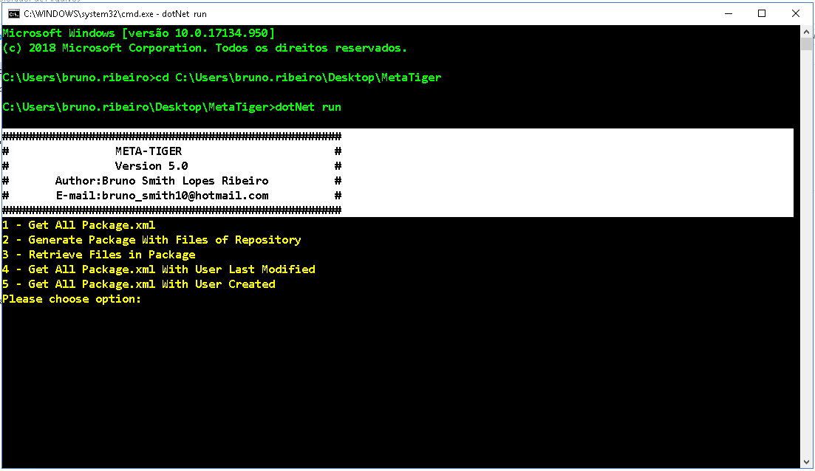
What are the features of MetaTiger?
Get All Package.xml
Get All Package.xml With User Created
Save settings and parameterization.
Generate Package With Files of Repository
Retrieve Files in Package
Get All Package.xml With User Last Modified

Slide 13


Get All Package.xml
This feature serves to get a list of all metadata in your organization. They will be added in a package.xml in the MetaTiger directory called package.
You will need the environment login data.
The package.xml that will find all the metadata in your organization will appear in the package directory.

Slide 14
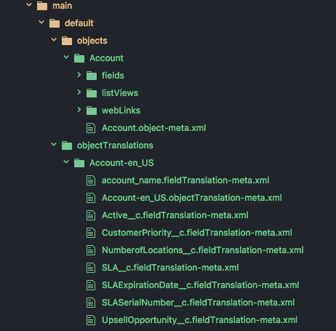

Generate Package With Files of Repository
This feature is for taking the files that are stored in your repository and preparing for deployment.
We will need a package.xml.
We will need the directory where the metadata is located and where the package should be created.

Slide 15


Retrieve Files in Package
This functionality serves to download the metadata mentioned in a package.xml just pass the organization and path that it will download in the package directory a zip file.
We will need a package.xml.
The metadata will be downloaded to the main directory called MetaTiger package.

Slide 16


Get All Package.xml With User Last Modified.
This feature has a responsibility to accept anything that has been changed by a user list in the sandbox or organization by adding a start and end date. A package.xml will be created in the MetaTiger root directory with only the appropriate changes for each user.

Slide 17

Get All Package.xml With User Created.
This feature has a responsibility to accept anything that was created by a user list in the sandbox or organization, adding a start and end date. A package.xml will be created in the MetaTiger root directory with only the appropriate creations of each user.

Slide 18









Benefits after using MetaTiger
More time for productivity and creativity
Better management
Task Optimization

Slide 19


New features for MetaTiger?
User List in MetaTiger Selection
Deploy In MetaTiger
More metadata
Migration Wizard Data

